Slide 1
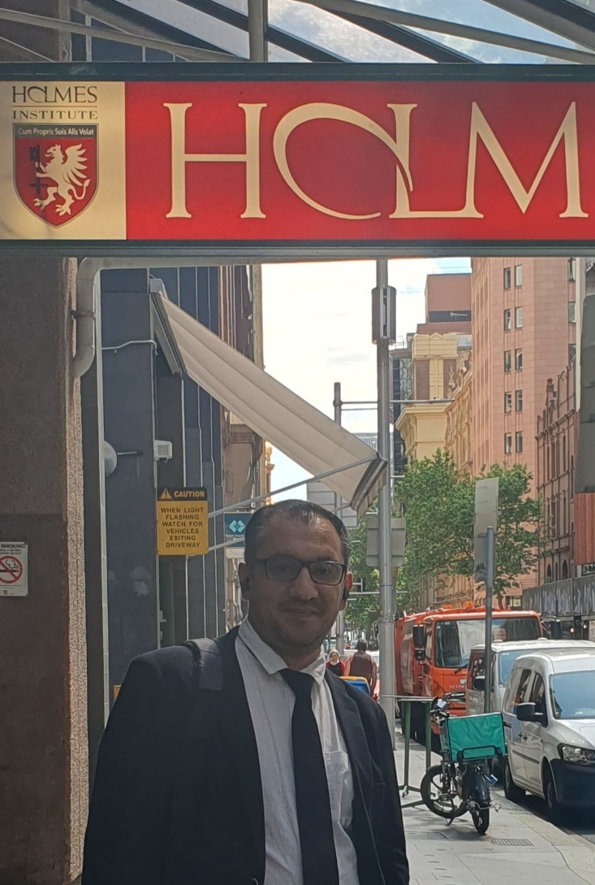

HI6034: Enterprise Information Systems Preparation for Online Test 1 (Week 2 and 3)

Slide 2
Question 1
In SAP S/4HANA, what is the main role of the General Ledger (G/L)?
To track employee attendance
To store all financial transactions in one place
To manage supplier payments only
To list all customer details
Explanation: The G/L is like the “main book” where all financial data is recorded.

Slide 3
Question 2
Which item is usually part of a Bill of Materials (BOM)?
Colour of the product
Delivery date
Quantity of parts
Customer feedback
Explanation: A BOM lists the materials needed to make a product, including how many of each item.

Slide 4
Question 3
SAP S/4HANA can be accessed using both SAP GUI and web-based tools like SAP Fiori.
True
False
Explanation: SAP S/4HANA supports modern web interfaces (like Fiori), not just the old SAP GUI.

Slide 5
Question 4
The General Ledger (G/L) keeps a complete and central record of financial transactions in SAP S/4HANA.
True
False
Explanation: All accounting entries eventually go into the G/L.

Slide 6
Question 5
Financial Accounting (FI) in SAP S/4HANA mainly focuses on external reporting (like financial statements).
True
False
Explanation: FI is used for reports shared outside the company, like balance sheets.

Slide 7
Question 6
When recording a Goods Receipt, you need to specify where the goods will be stored.
True
False
Explanation: The system needs a storage location to know where items are kept.

Slide 8
Question 7
A Purchase Order can sometimes be created without a Purchase Requisition.
True
False
Explanation: While often used, a requisition is not always required before creating a PO.

Slide 9
Question 8
What is the main purpose of a Goods Receipt in SAP S/4HANA?
To approve vendor payment
To increase stock and record received goods
To create a purchase order
To cancel an order
Explanation: Goods Receipt updates inventory and confirms items have arrived.

Slide 10
Question 9
Which of the following is important in a Purchase Order?
Marketing Region and Sales Office
Purchasing Organisation and Purchasing Group
Plant and Storage Bin only
Company Code and Currency only
Explanation: These define who is responsible for buying goods.

Slide 11
Question 10
In ERP projects, moving to the next stage usually requires approvals.
True
False
Explanation: Each phase must be approved before continuing to ensure quality and control.

